Slide 1
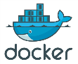
Emerging Areas: Virtualization / Agile Adopting Agile Environment : Utilizing Docker Containers For Accelerating & Optimizing Testing
Authors - Khelender Sasan & Divya Saxena
(NEC Technologies India Ltd.)

Slide 2
Agenda
Background
scenario of technology world
Technology’s business impact…
Agility
Cost
Newer Paradigms
Docker Technology
Introduction
Docker Architecture
Use Cases For Application Of Docker Containers
Technology usage demonstration
References

Slide 3

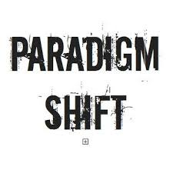

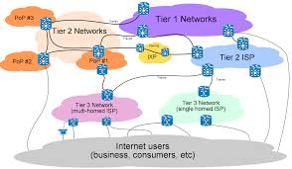
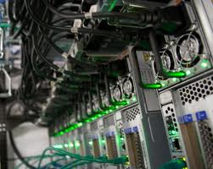

Background scenario of today’s technology world !
Time to market is crucial !!
Resource cost optimization is also crucial (to thrive in competing world!)
Hardware optimization reached level of micro-servers (in parallel to HPC!)
Newer paradigm of software are evolving (that needs to be handled by new paradigm in testing!)
Distributed computing (Docker container has started making some inroads here as well !)
Cloud (model) presence is ubiquitous

Slide 4

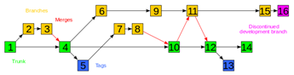
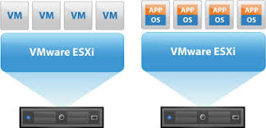
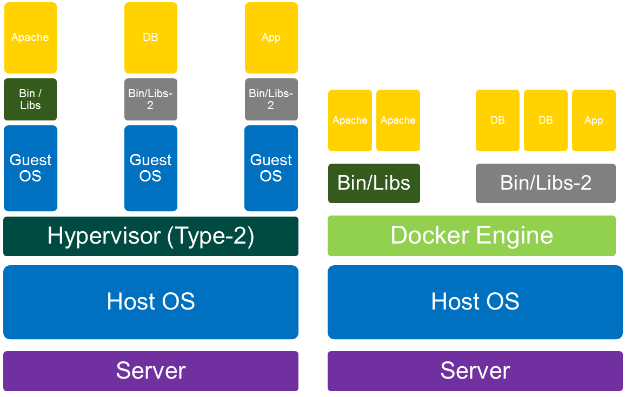
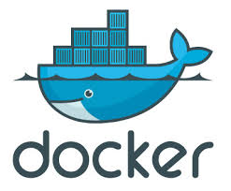
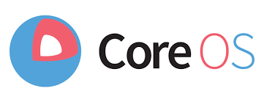
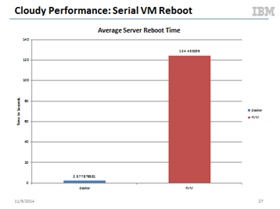
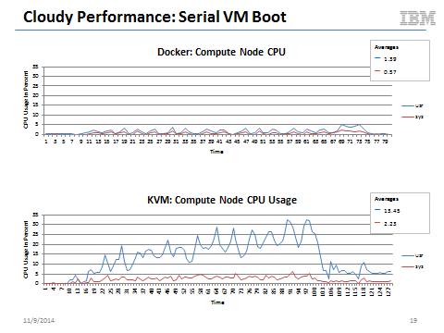
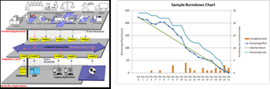
Agility…
Agility performance is paramount !
(Agile methodology & environment)
Provides much better performance as compared to VMs
Launch time in sub-seconds: Reduced cycle time of test environment deployment and execution
Ease out configuration management of resource (Inherent CM)
Enhance CI / CD execution cases
Decreased development and QA time (by ensuring replica environment with all dependencies across stages)
Automation frameworks (orchid/fig)
Optimized server environments
(shorten release cycles:
some orgs @ 3 release / day)
Execution speed is much higher (ms launches versus few seconds)
Sharing OS, Binaries & Libraries
Notes:
Sharing OS: No separate OS to load / execute

Slide 5

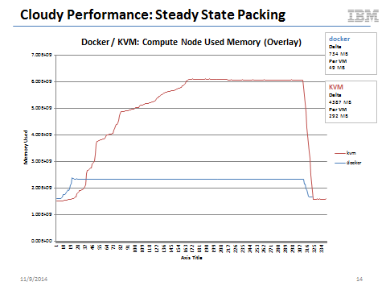
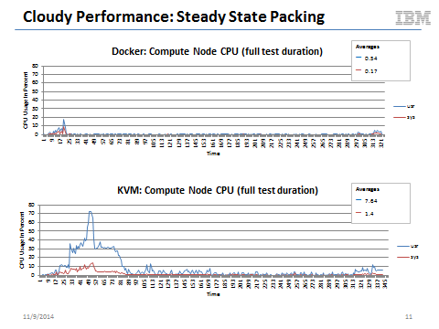
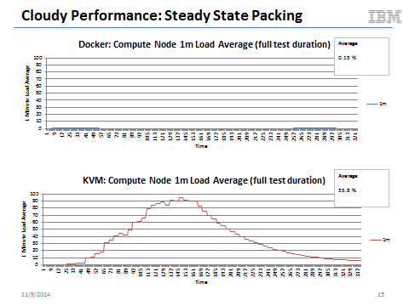
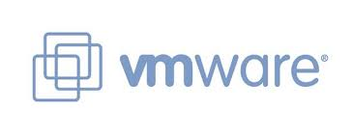
Costing…
Work so far
Cloud performance optimization ! (VM performance improvement Several GB -> 100 MBs)
Docker container offer much better density than traditional VMs
can scale ~10x – 100x
Compute Resource Optimization
Support Cost Optimization
License Cost Optimization (Pure OSS versus commercial VMs)
Density of virtual entities is much higher
Notes:
http://www.slideshare.net/Docker/performancecharacteristicsoftraditionalvmsvsdockercontainersdockercon14-140613162917phpapp02-37588947

Slide 6
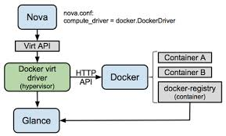
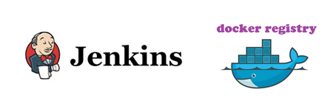
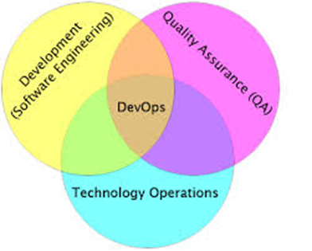
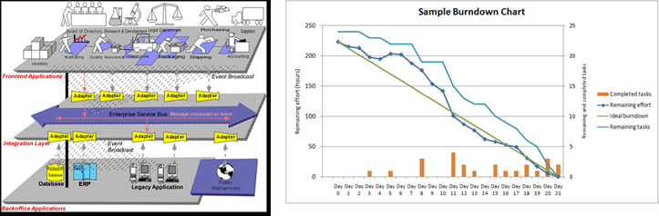
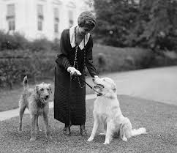
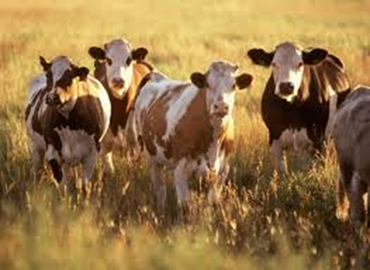
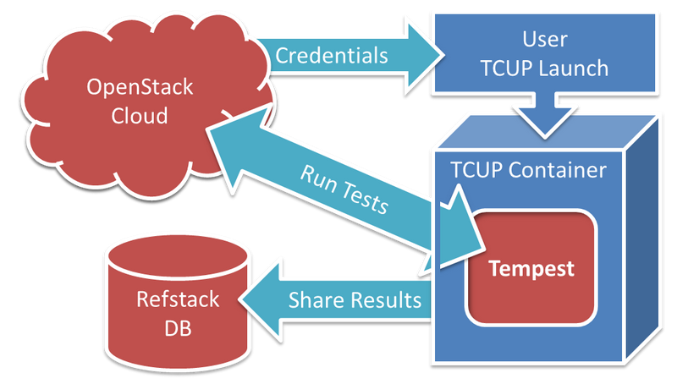
Strengthening new Paradigms!
Cloud
Enhanced performance of OpenStack through docker support in Nova (Compute engine)
CI-CD & DevOps
Thousand of off-the shelf docker images for quick launch without repeated installs !
Accelerated environment replication using CM facility!
Computing Resource treatment as pet versus cattle
Cloud deployments Interoperability testing (OpenStack Cloud framework)
Refstack using docker
Pets
Versus
Cattle!

Slide 7

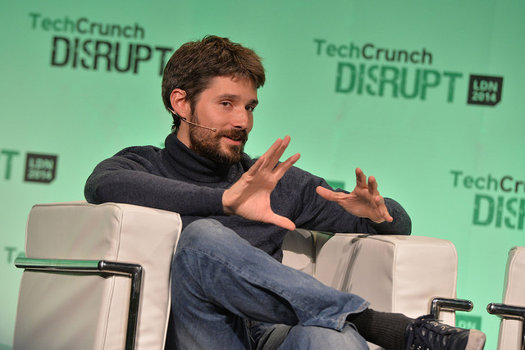

Solomon Hykes: person behind Docker Container
DotCloud : Provides Cloud solutions
Brain behind Docker : Solomon Hykes
Theme / Motto :
“The real value of Docker is not technology, it's getting people to agree on something.”

Slide 8
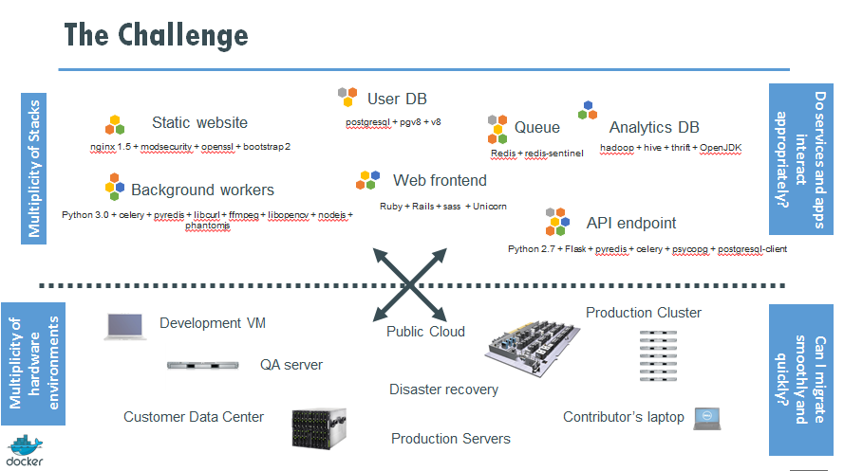
Challenge of Software Industry
Source: http://www.slideshare.net/Docker/dockerintronovember-131125185628phpapp02-37588934

Slide 9
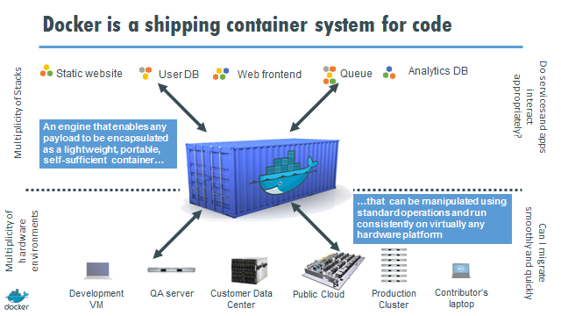
Solution
Source: http://www.slideshare.net/Docker/dockerintronovember-131125185628phpapp02-37588934

Slide 10
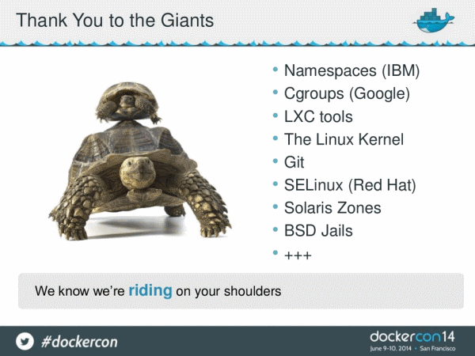
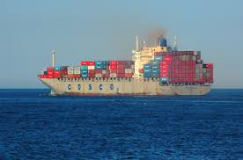
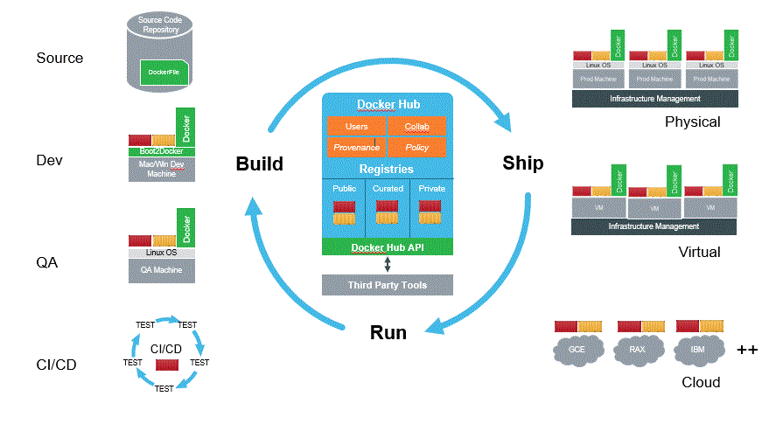
Solomon Hykes: person behind Docker Container
DotCloud : Provides Cloud solutions
Brain behind Docker : Solomon Hykes
Theme / Motto :
“The real value of Docker is not technology, it's getting people to agree on something.”
Got inspiration of solution for software troubles from Shipping Industry
Nothing New => Just recipe was required !
Acknowledged all recipe ingredients in Docker Conf’14

Slide 11
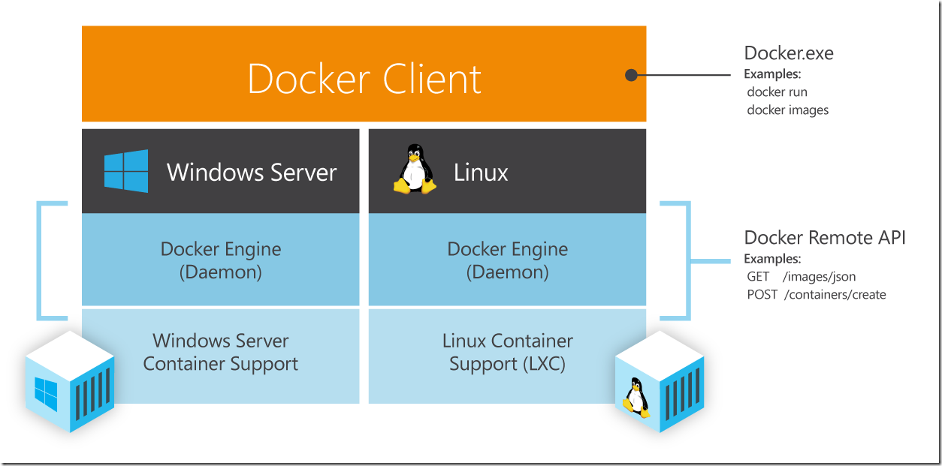
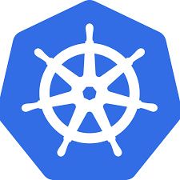

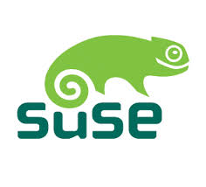


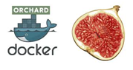


Docker Containers and technology business ecosystem
Microsoft & Docker
Docker and Microsoft partner to bring container applications across platforms (15-Oct-2014)
Google & Docker
Google Launches Managed Service For Running Docker-Based Applications On Its Cloud Platform (4-Nov-2014)
Google Container Engine to use Kubernetes for providing “Docker as a Service” (“Cluster As a Service”?)
Linux Distros & Docker
Canonical Releases Ubuntu 14.10 With Tighter Docker and Cloud Foundry Integrations (24-Oct-2014)
SUSE bundles Docker and processor optimizations into major new Linux distro (27-Oct-2014)
Red Hat To Bring Docker Support To Enterprise Linux And OpenShift (15-Apr-2014)
Docker acquisitions
Docker acquires Orchard (for Orchestration & integration platforms)
Docker Acquires Koality In Engineering Talent Grab (7-Oct-2014)
Server Environment Optimization (CoreOS) : Planning to serve a diet Linux Platform
Every App / Service will be served using docker container !
Notes:
- Canonical competing with Docker by working on LXD?

Slide 12

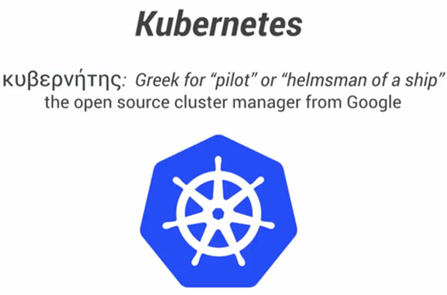
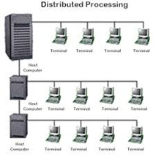
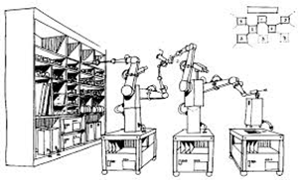



Creating newer solutions & Paradigms !
Distributed Computing
Clustering automation & Orchestration (Kubernetes)
Server Optmization (CoreOS)
Library for running docker container in cloud (fig, orchard)
Libraries / solutions for automation in distributed space
Libchan, libswarm
Challenging environment for QA:
Hardware : Micro-servers (form factor based)
Software : Distributed / Cloud based
Testing (system and overall) going to be challenging, where components can be present across physical deployments of units
Need to work in optimal space without disturbing development environment
Non-invasive testing can be enabled by Docker (remember OpenFlow in SDN)
More possibilities
Can easily support integration of Virtual environment in Automation Frameworks!
More Testing Scenarios
Interoperability
Network space
Supports nested virtualization (and inner processes running in native environment only!)
Acceleration of software setups on Fresh Hardware setups

Slide 13
Hypervisor VM versus Docker Containers
Virtual Machine (Hardware virtualization)
Includes hardware simulation & OS execution
Docker containers
(OS level virtualization)
Based on Linux Containers and Union File System.
Requires order of few MBs of memory for each instance (Light Weight)
Instance launched in sub-second time-frame (much faster)
Requires order of GB – 100s of MBs of memory for each instance (Heavy Weight)
Can simulate few VMs per server (Expensive)
Instance launch complete takes several seconds minute (slower)
Can simulate much higher containers per server (Cheaper)

Slide 14
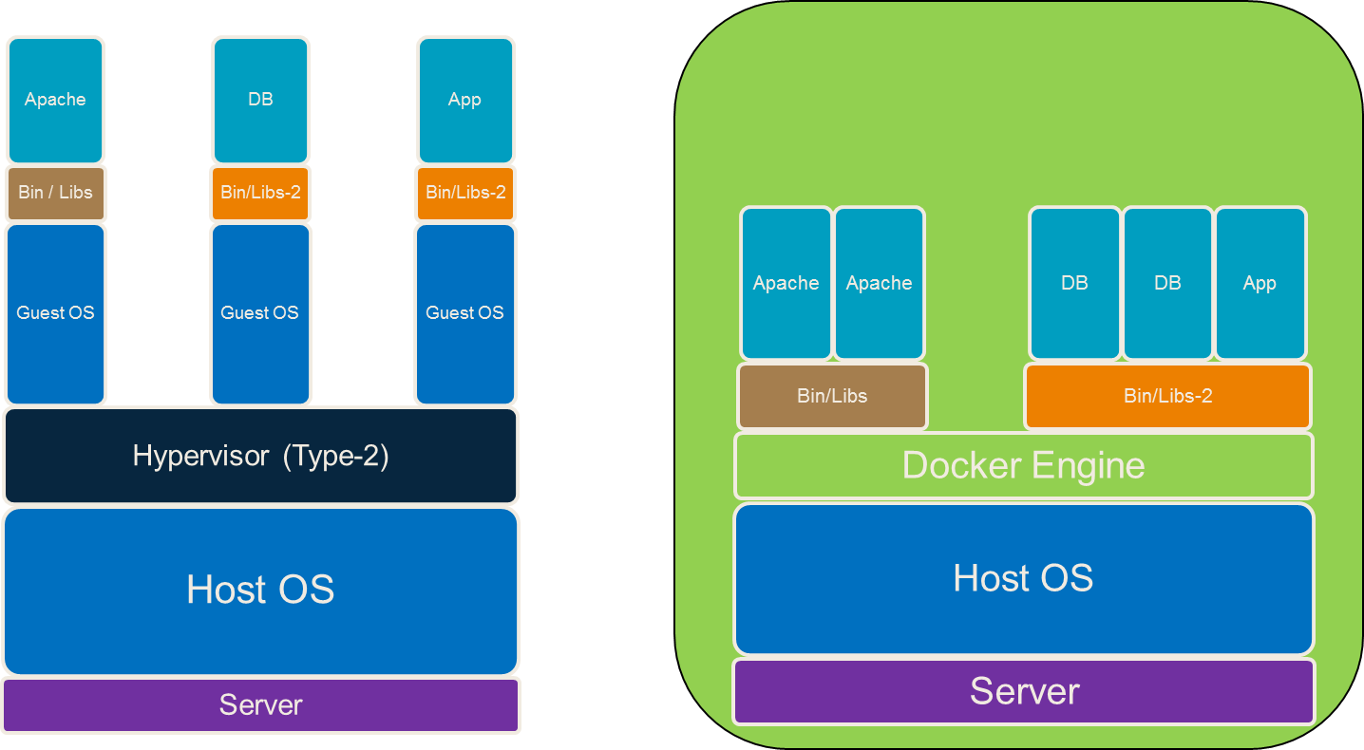
Docker Technology : Introduction
Framework built on top of Linux containers that can package an application and its dependencies => Can be launched / deployed in form of software container on any Linux server (providing portability of underlying platform: cloud, bare-metal, server, desktop or laptop)
Traditional Hypervisor based VMs
Container based Application execution

Slide 15


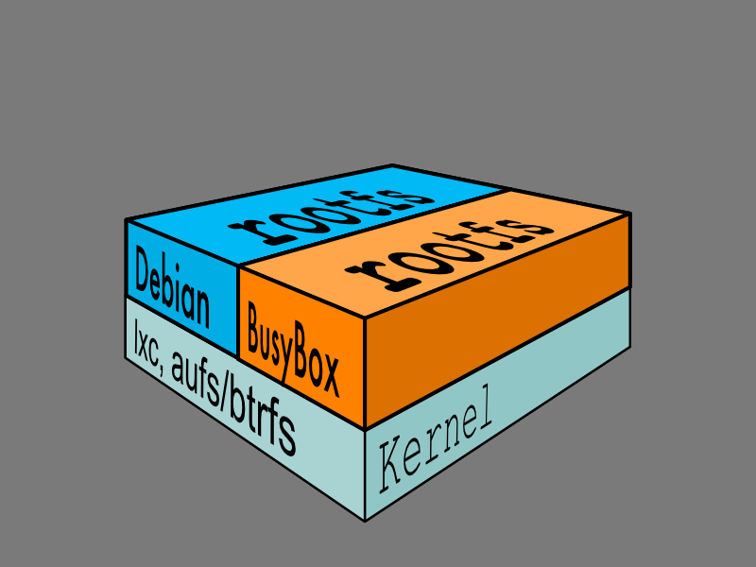
Docker Technology Introduction….continued…
Container relies on Linux kernel facilities: chroot, cgroups and name-space facilities that provide resource isolation (CPU, memory, block I/O, network, etc.) => Doesn’t require a separate OS instance.
Docker uses AUFS (Advanced multi-layered Unification File System) – It greatly enhances the performance of docker containers and provides for optimized usage of underlying disk resources
Docker provides versioning capability to track successive versions of a container
Docker provides framework & a high level API over Linux containers for portable deployment of applications across machines

Slide 16
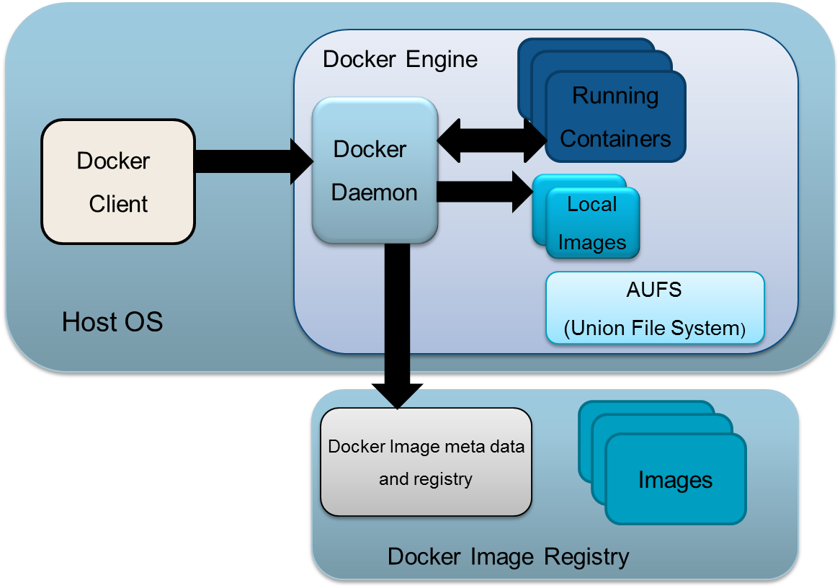
Docker Architecture

Slide 17
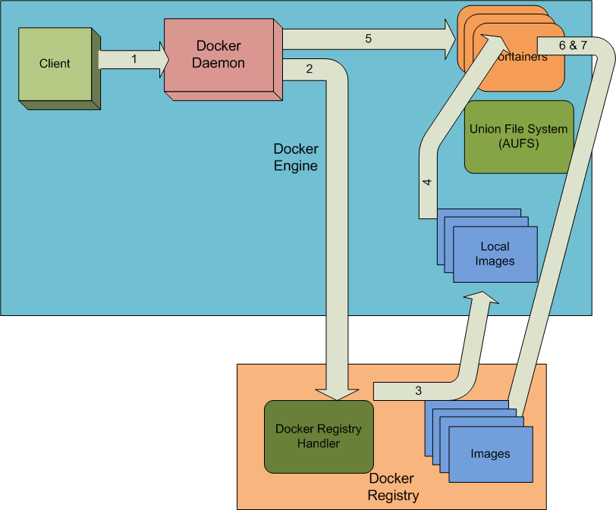
Usage Flow

Slide 18
Initial Benchmarking Results (1/3)

Slide 19
Initial Benchmarking Results (2/3)
Host A

Slide 20
Initial Benchmarking Results (3/3)
Work Load =
200 images
Work Load = 600 images
Host A

Slide 21
Use Cases For Application Of Docker Containers
Networking scenarios
Scalability testing
Non-invasive testing
Application Stress testing: behavior validation
Optimize frequent installs & setups during fresh hardware bring-up
Implementation optimizations
Interoperability testing across Linux Distributions and application packages

Slide 22
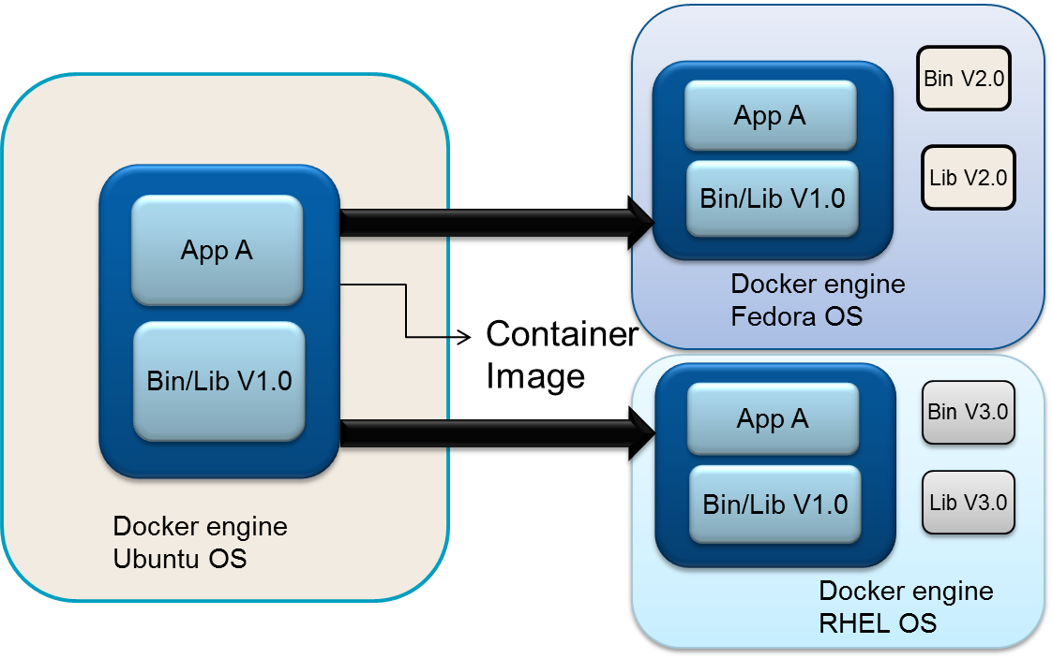
Distributions / Interoperability testing (1/3)
Testing an application along with required library versions (using bundled images) across various different Linux systems

Slide 23
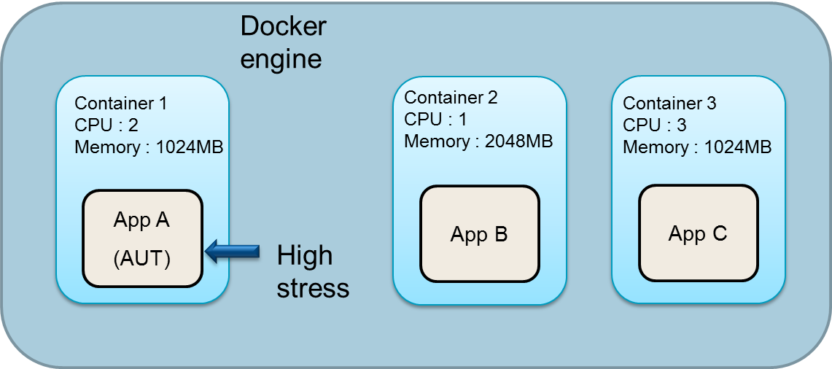
Stress Testing Validation
Application Stress testing: behavior validation

Slide 24
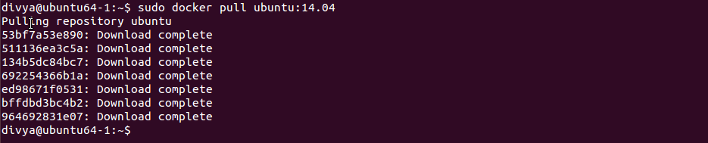
Technology Usage Demonstration (1/5)
Docker installation
Download an existing container image from public docker registry

Slide 25
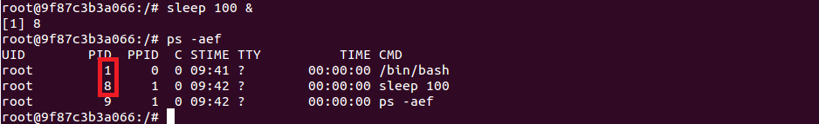
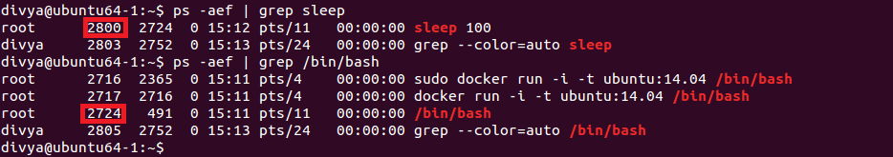
Technology Usage Demonstration (2/5)
Spawning container from downloaded container image
OS level virtualization demonstration

Slide 26
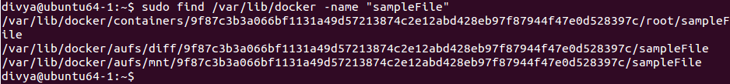
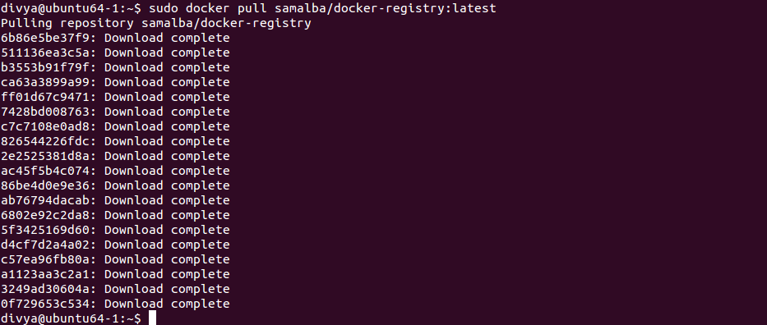
Technology Usage Demonstration (3/5)
Concept of chroot and aufs
Setting up local private docker registry

Slide 27
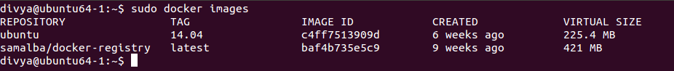
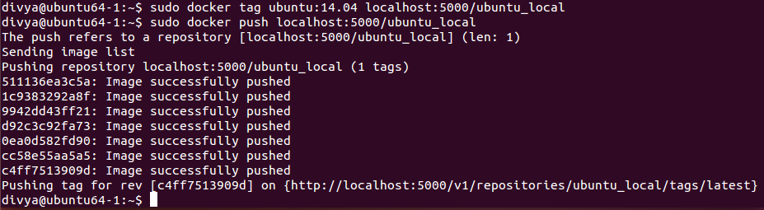
Technology Usage Demonstration (4/5)
Uploading images in local private docker registry

Slide 28
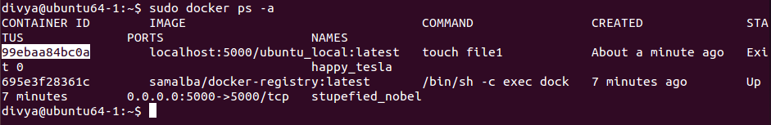

Technology Usage Demonstration (5/5)
Versioning (Committing changes as new image)

Slide 29
References
Docker (http://www.docker.com/)
Introduction to Docker (November-2013) http://www.slideshare.net/Docker/dockerintronovember-131125185628phpapp02-37588934
Docker: Automated and Consistent Software Deployments (http://www.infoq.com/news/2013/03/Docker)
Running private repository (https://blog.codecentric.de/en/2014/02/docker-registry-run-private-docker-image-repository/)
Docker performance characteristics
http://bodenr.blogspot.in/2014/05/kvm-and-docker-lxc-benchmarking-with.html
Budge around Docker
Docker and Microsoft partner to bring container applications across platforms (http://news.microsoft.com/2014/10/15/dockerpr/)
Google to offer Docker as a Service (using Kubernetes) (http://siliconangle.com/blog/2014/11/06/with-docker-as-a-service-google-wants-developers-to-think-beyond-cloud/)
CoreOS (based on docker) as a lean and mean virtualization machine (http://www.networkworld.com/article/2840343/opensource-subnet/coreos-a-lean-mean-virtualization-machine.html)
Docker Acquisitions
Docker acquires Koality (http://techcrunch.com/2014/10/07/docker-acquires-koality-in-engineering-talent-grab/)
Docker acquires Orchard (http://www.zdnet.com/docker-acquires-london-startup-orchard-laboratories-7000031921/)
Miscellaneous
Ubuntu server 14.10 adds new features for docker containers (http://siliconangle.com/blog/2014/10/23/ubuntu-server-14-10-adds-new-features-for-openstack-containers/)
Automated Testing of Hardware Appliances with Docker (http://www.appneta.com/blog/automated-testing-with-docker/)

Slide 30
Questions?
Thanks

Slide 31


